Slide 1
E-Commerce RETAIL DATA ANALYSIS
SHOP
Submitted By-
Sahil Ahamed
Punamchand Gumladu

Slide 2






Introduction
E-commerce retail data analysis involves the exploration, interpretation, and utilization of this data to derive actionable insights.
Analyzing data from various platform such as python and Mysql and excel and for better understanding we have create some visualization using tableau PowerBi.
The primary goal of e-commerce retail data analysis is to optimize various aspects of the retail business, including sales, marketing and Product sales analysis . By leveraging advanced analytical techniques and technologies, retailers can.
Identifying top-selling products, popular categories, and sales trends, retailers can optimize their product assortment, pricing strategies, and promotional activities to maximize sales revenue.

Slide 3
E-Commerce RETAIL DATA ANALYSIS
Data Visualization (Python, Tableau, Power BI)
Exploratory Data Analysis (EDA)
Machine Learning (Python)
Data Collection
Database Queries (MySQL)
Exploratory Data Analysis (EDA)
Data Collection
Database Queries (MySQL)
Visualization (Python, Tableau, Power BI)une
Machine Learning (Python)
Ensure data integrity by collecting sales data from various sources (e.g., Kaggle, CSV files)
Explore the sales data using Python libraries like Pandas, NumPy, and Matplotlib/Seaborn.
Write SQL queries to extract relevant data from the MySQL database.
Apply machine learning techniques to predict The order is accepted or returned.
Create interactive visualizations using Python libraries such as Matplotlib, Seaborn and we have used Power Bi, Tableau also.

Slide 4


Data Collection
Ensure data integrity by collecting Ecommerce sales data from various sources (e.g., Kaggle, CSV files).
We have read the data from excel and we understand the variables and we found out this data will be enough for analysis.

Slide 5
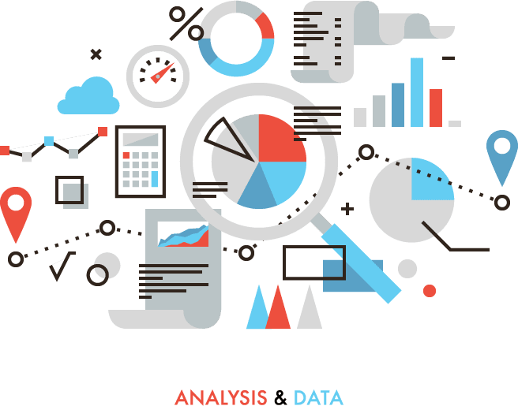




Exploratory Data Analysis (EDA)
Explore the sales data using Python libraries like Pandas, NumPy, and Matplotlib/Seaborn.
Analyze sales trends, seasonal patterns, and correlations between variables.
Identify top-selling products, popular categories, and customer segmentation.

Slide 6
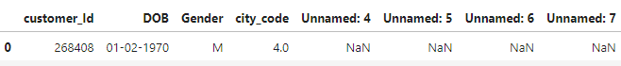
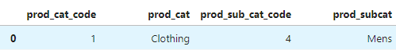
Exploratory Data Analysis (EDA)
We are having 3 datasets right here customer _new, transactions _new and Prod_info.
customer _new having 8 columns and 4 of them is unwanted columns which having only null values. And this dataset store details about customers
transactions _new having 10 columns and this dataset stores details about transactions and products codes.
Prod_info having only 4 columns. Its store details about products along with their products codes.

Slide 7
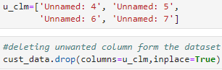
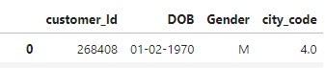
Exploratory Data Analysis (EDA)
Data Cleaning
In data cleaning process we have deleted some unwanted columns form our customer_new dataset using drop method and after deleting columns we have now 4 columns.
And we have add a columns on transactions_new and prod_info for merging purose “Join_id” which is concatenation of two columns prod_cat_code and prod_subcat_code.
After that we have merged all the dataset into one dataset and we saved it with merged_data name.

Slide 8
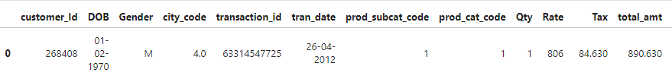
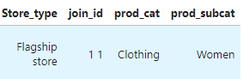
Exploratory Data Analysis (EDA)
We have used Inner join for merging the all the datasets and we used it coz there will be no duplicate values.
Now in our final datasets we are having 16 variables

Slide 9
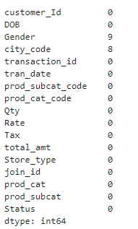
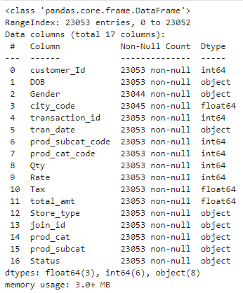
Exploratory Data Analysis (EDA)
We have check the info about our final dataset and we have checked for the null values. And we are having 9 null values in Gender and 8 null values are in city code. we have replaced the null values with the mode(the number that appears most often in a set of data).

Slide 10
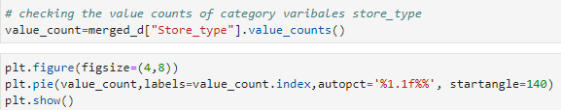
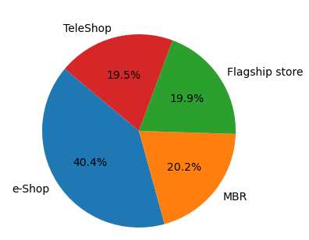
Exploratory Data Analysis (EDA)
In the Store type variable we have 4 types of store.Where E-shop is having 40.4% which is highest percentage of sales. And TeleShop is having only 19.2% sales.

Slide 11
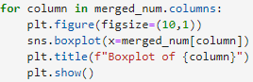
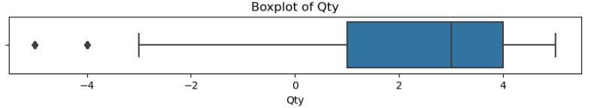
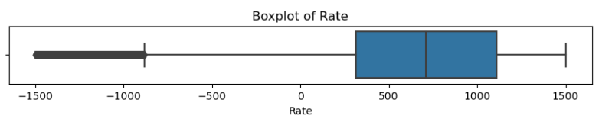
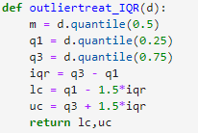
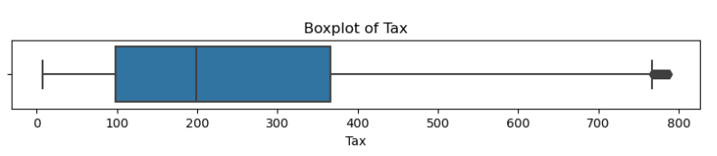
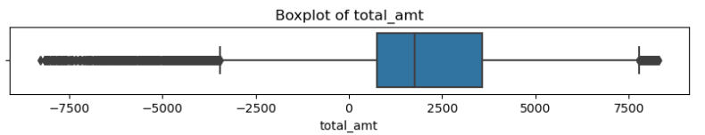
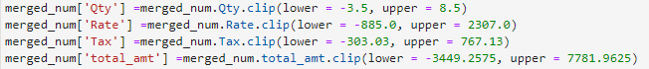
Exploratory Data Analysis (EDA)
We have check for the outliers in our dataset using seaborn boxplot. And we have detect some outliers in our 4 columns like "Qty","Rate","Tax" and "Total_amt“ and treated them using clip method we clipped them with upper bound and lower bound.
And we have found lower bound and upper bound using this UDF function which is created by ourself.

Slide 12
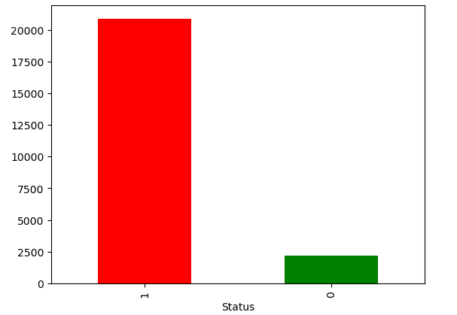
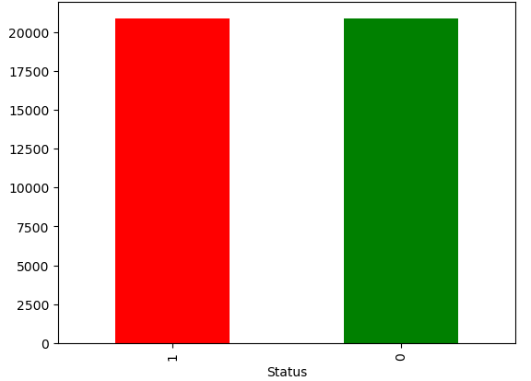
Exploratory Data Analysis (EDA)
Our target variable was unbalanced so Plotted that using bar plot. then we use the over sample technique for perfectly balanced the dataset.
Before Over Sample
After Over Sample

Slide 13
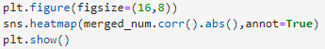
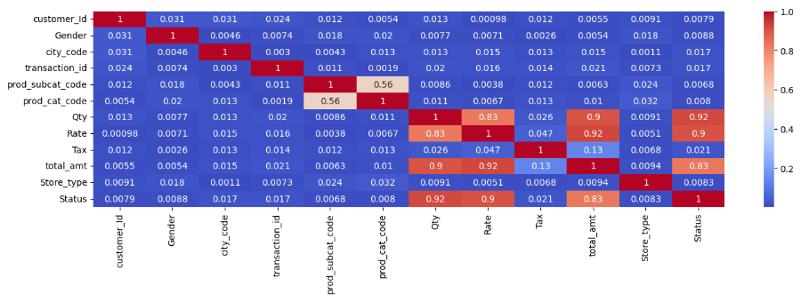
Exploratory Data Analysis (EDA)
Feature Engineering : Right here we used heat map for plot the correlation with our target variable “Status”. And very less amount of variables having good relation with target variable Like – “total_amount., ”Tax”, ”Rate” and “Qty”. So we decided that we are going to keep all the variables for next ML models.

Slide 14
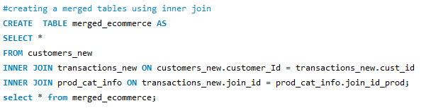
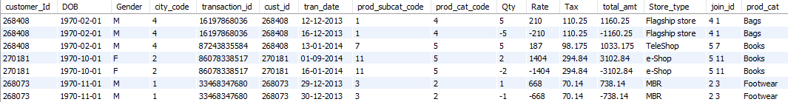
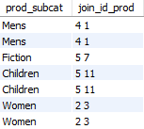
Database Queries (MySQL)
data preprocessing: In Database Queries we used Mysql workbench. Right here we have done data preprocess and Merged all the datasets into a final dataset and we have created a table for the final dataset.

Slide 15

Database Queries (MySQL)
Objectives:
Sales Analysis:
Identify top-selling products, categories, and brands.
Customer Behavior Analysis:
Segment customers based on their purchasing behavior.
Product Analysis:
Analyze product performance by sales volume, revenue.
Identify Top sales market.
Analyze product return rates and accept rates.

Slide 16
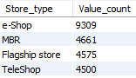
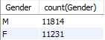
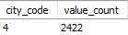
Database Queries (MySQL)
Q. which Store most frequently used for transactions?
Q. What is the count of Male and Female customer count in our datasets?
Q. From which city do we have the maximum number of customers and how many?

Slide 17
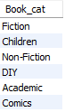
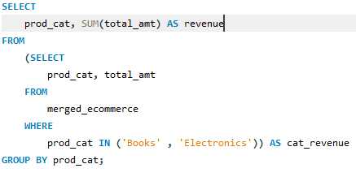
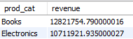
Database Queries (MySQL)
Q. How many subcategories are there under the books category?
Q. What is the net total revenue generated in categories Electronics and books?

Slide 18
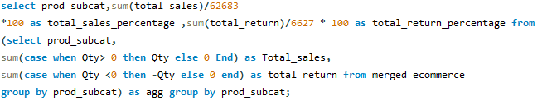
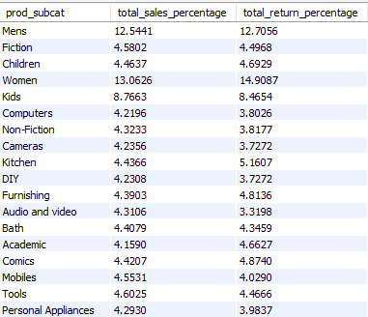
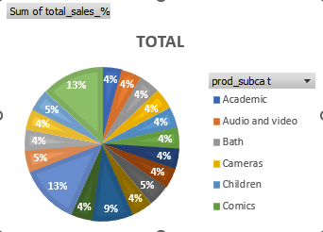
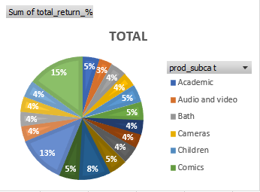
Database Queries (MySQL)
Q. What is the percentage of total sales and total returns with respect to their product sub category.?

Slide 19
Data Visualization (Python, Tableau, Power BI)
Create interactive visualizations using Python libraries such as Matplotlib, Seaborn, Plotly, or Bokeh.
Design informative dashboards in Tableau or Power BI to present key metrics and insights.
Visualize sales performance, product trends, geographical distribution, and customer behavior.

Slide 20
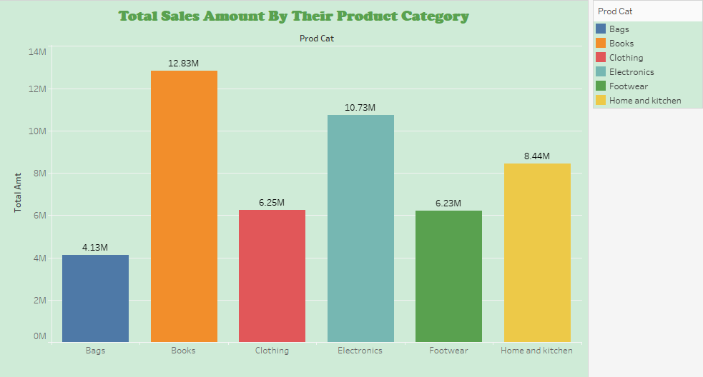
Data Visualization (Python, Tableau, Power BI)
Total sales amount by their product category Using Tableau
﻿At 12.83M, Books had the highest Sum of total_amt and was 210.88% higher than Bags, which had the lowest Sum of total_amt at 4.13M.

Slide 21
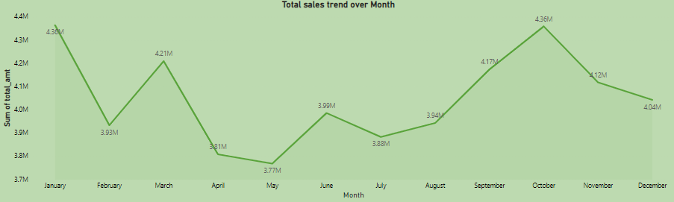
Total sales amount over month
Data Visualization (Python, Tableau, Power BI)
﻿At 4.36M, January had the highest Sum of total_amt and was 15.81% higher than May, which had the lowest Sum of total_amt at 3.77M

Slide 22

Ecommerce Sales Analysis

Slide 23
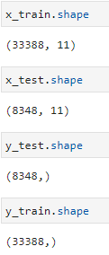
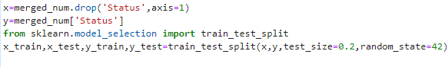
Machine Learning (Python)
Apply machine learning techniques to predict The order is accepted or returned.
These are the shape of our splitted data.
We have applied classifications models to predict the status of the order “Return” or “Accepted”.
We will predict the future status of the order form these historical datasets.
And we split the data into test data and training data. Test having 20% of the dataset and training having 80% of the data.

Slide 24

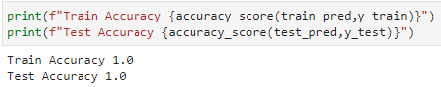
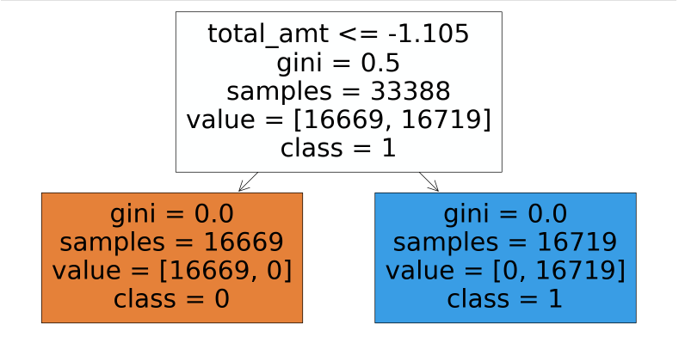
Machine Learning (Python)
Decision Tree: we used sklearn library for Decision Tree classifier modle. Right here we predicted the train test both the dataset then we printed the accuracy of both. And the accuracy is 100%.
And we plotted the plot tree using sklearn.tree library
Plot Tree

Slide 25
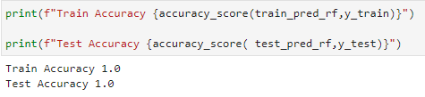
Machine Learning (Python)
Random Forest classifier Model:
We initialize the Random Forest Classifier with RandomForestClassifier() constructor. We specify the number of trees (n_estimators) in the forest. random_state is used for reproducibility.
We train the Random Forest Classifier model using the fit() method on the training data.
We use the trained model to make predictions on the test set using the predict() method.
e calculate the accuracy of the model by comparing the predicted labels with the actual labels in the test set using the accuracy_score() function.
Model Training

Slide 26
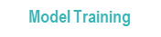
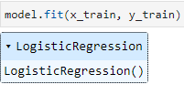
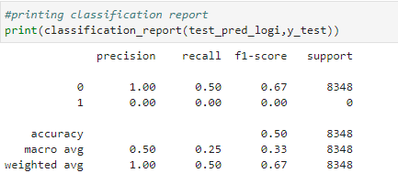
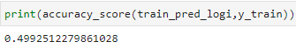
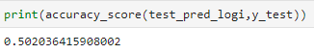
Machine Learning (Python)
Logistic regression model:
We initialize the Logistic Regression model with LogisticRegression() constructor. max_iter specifies the maximum number of iterations taken for the solvers to converge. random_state is used for reproducibility.
We train the Logistic Regression model using the fit() method on the training data.
We use the trained model to make predictions on the test set using the predict() method.
We calculate the accuracy of the model by comparing the predicted labels with the actual labels in the test set using the accuracy_score() function.
Classification Report
Accuracy

Slide 27
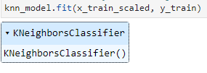
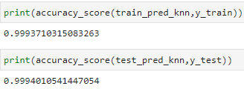
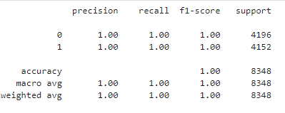
Machine Learning (Python)
Model Training
K-Nearest Neighbors (KNN) Model:
We initialize the KNN model with KNeighborsClassifier() constructor. n_neighbors specifies the number of neighbors to consider.
We train the KNN model using the fit() method on the training data.
Making Predictions: We use the trained model to make predictions on the test set using the predict() method.
Model Evaluation: We calculate the accuracy of the model by comparing the predicted labels with the actual labels in the test set using the accuracy_score()
Accuracy
Classification Report

Slide 28



Machine Learning (Python)
Confusion Matrix
Naive Bayes Model:
We train the Naive Bayes model using the fit() method on the training data.
We use the trained model to make predictions on the test set using the predict() method.
We calculate the accuracy of the model by comparing the predicted labels with the actual labels in the test set using the accuracy_score() function. We also generate a classification report using classification_report() to get more detailed metrics like precision, recall, and F1-score.
Classification Report
Accuracy

Slide 29

Machine Learning (Python)
Accuracy Comparison for Different Models
Right here we have created a bar graph for comparison purpose. As we can see in KNN, Decision Tree and Random Forest models having same accuracy but Logistic regression and Naïve Bayes having lowest accuracy in our models.

Slide 30
CONCLUSION
At the starting of this project we got 3 dataset. then we merge them into a final dataset on that dataset we apply EDA.
We analyze the dataset then we found some useful insight like In the Store type variable we have 4 types of store. Where E-shop is having 40.4% which is highest percentage of sales. And TeleShop is having only 19.2% sales.
In Mysql part we have done same thing like merging the dataset into one. In this part we mainly focused on product analysis and some customer behavior analysis. As we explained previously in the "Book" category we have 6 sub category and in the city code 4 is having maximum customers.
In the visualization part we have analyze lots of insights like in January having maximum sales which is 15.81% higher than May, which had the lowest Sum of total_amt at 3.77M. And form the dashboard we found some insight like in 2014 suddenly our sales are decreased by 0.09M.
In machine learning modeling part we have created 5 different models Decision Tree, random Forest, Logistic Regression, K-Nearest Neighbors (KNN) Model and Naive bayes. In here 3 models are having good accuracy but naive bayes and Logistic regression having very less accuracy so from 3 models we choose as final models is KNN Model. We choose this model as final because its easy to implement and easy to understand and KNN is a simple and intuitive algorithm that doesn't require assumptions about the underlying data distribution.

Slide 31



Address
Ashuria,birbhum, Westbengal, 731237
Contact Number
+917384733625
Email
Ahamed.sahil.official@gmail.com
Social link
www.linkedin.com/in/sahil-ahamed-a1b7a6253

